Slide 1


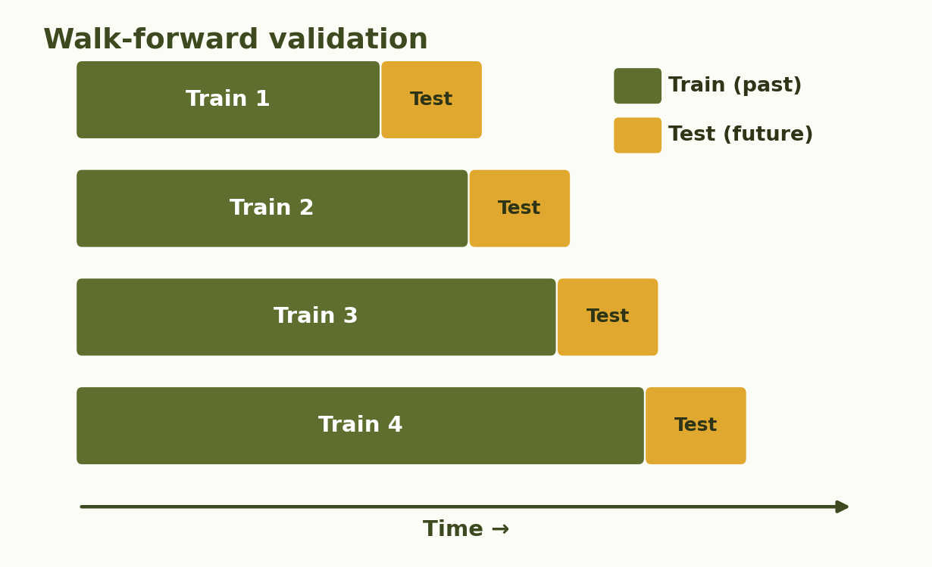
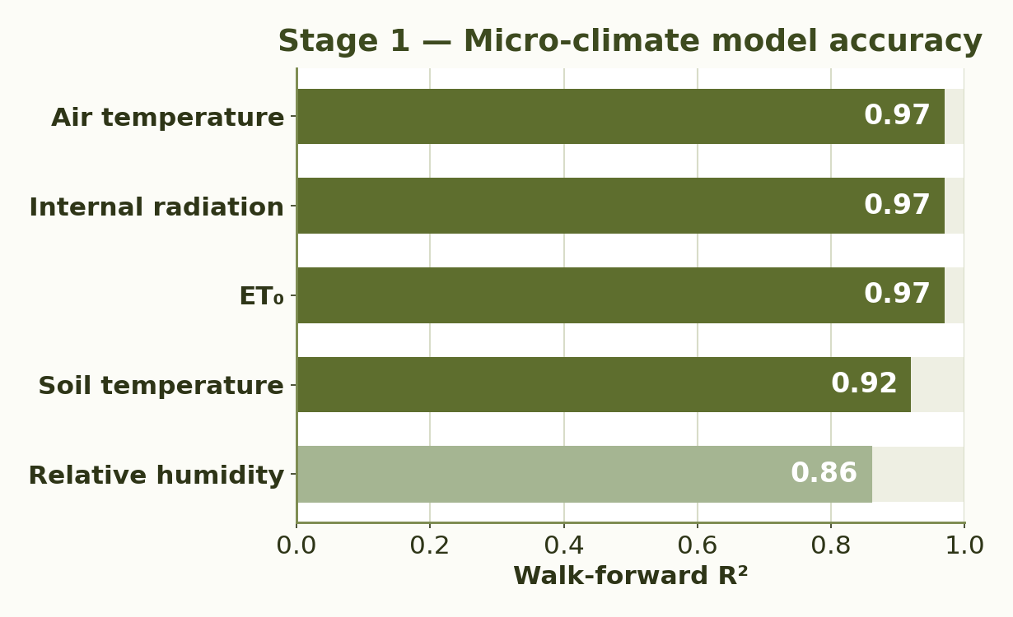
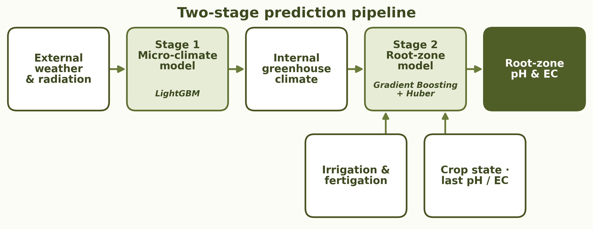
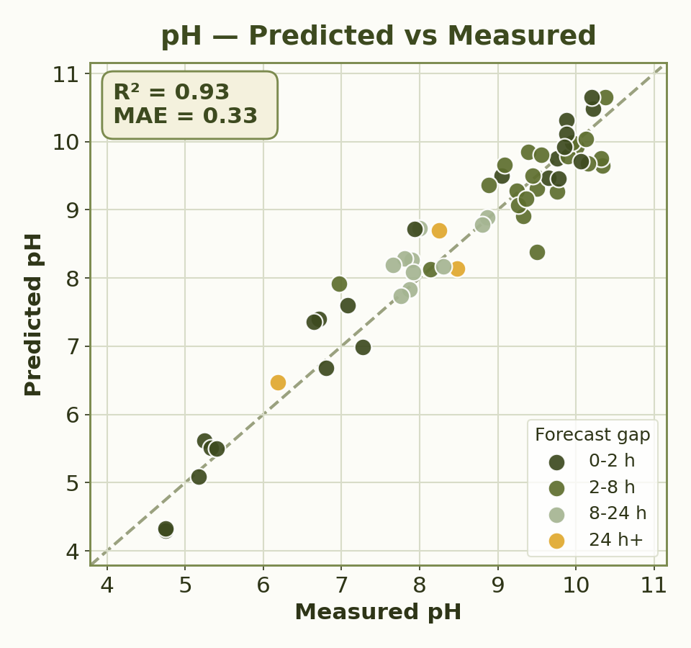
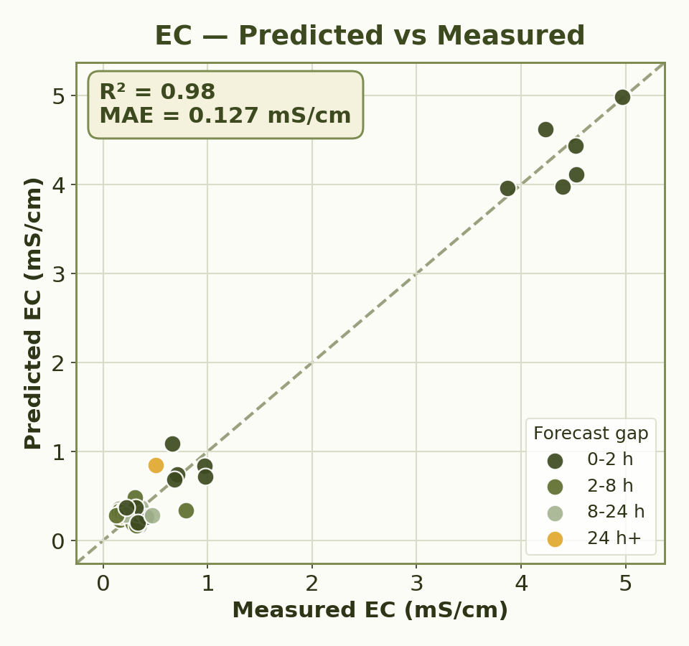
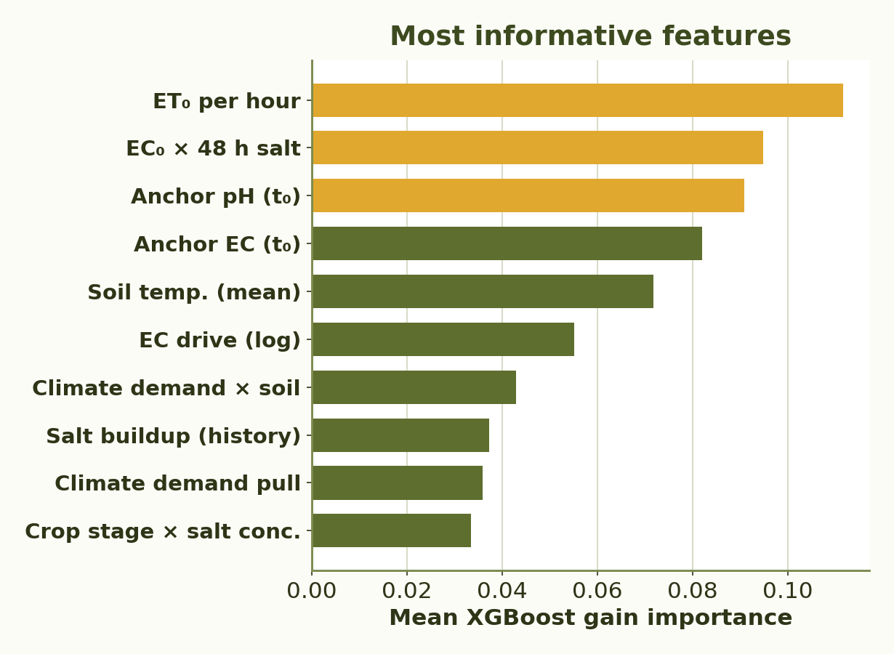
RUPPIN ACADEMIC CENTER · DEPARTMENT OF COMPUTER SCIENCE · AI & DATA SCIENCE SPECIALIZATION
Predictive Modeling of Root-Zone Variables Using Greenhouse Data
Students: Eden Eliyahu, Oren Chaushu
Supervisors: Dr. Avner Priel, Dr. Alaa Jamal
01
Motivation
06
Validation Strategy
Root-zone pH controls nutrient availability; EC (electrical conductivity) reflects salinity and fertilizer load.
Manual lab samples are accurate but sparse, creating blind gaps between measurements.
A soft sensor can forecast pH and EC between lab samples, helping growers detect drift earlier and adjust irrigation/fertigation decisions.
▪ Walk-forward validation matches deployment: future pH/EC is predicted from past labels, forecasted climate and planned irrigation/fertigation.
▪ Future pH/EC labels are never used for training until after that sample becomes available.
02
Project Goal
▪ Predict future root-zone pH and EC from the latest lab measurement, forecasted climate, planned irrigation/fertigation and crop-state data.
▪ Estimate the t₀ → t₁ change so growers can test a planned irrigation/fertigation strategy, see expected future pH/EC values, and adjust before conditions drift.
07
Micro-Climate Model
03
Data
▪ Predicts internal greenhouse climate from external weather and radiation.
▪ Generates continuous climate inputs - temperature, RH, radiation, ET₀ and soil temperature - for the root-zone model.
16,682
10-min rows
109
pH / EC labels
+20
input features
▪ Unified 10-minute master dataset · May 29 – Sep 21, 2025. ▪ External weather & solar radiation.
▪ Greenhouse micro-climate. ▪ Irrigation & fertigation. ▪ Crop-state features. ▪ Manual laboratory pH & EC measurements.
04
Method
Two-stage prediction pipeline:
1. Forecast internal greenhouse micro-climate from external weather and radiation.
2. Predict t₀ → t₁ root-zone pH/EC change using climate, crop state and planned events.
08
Root-zone Model Results - Walk-forward Test
0.33 pH MAE
0.93 pH R²
+62% pH gain
0.127 EC MAE
0.98 EC R²
+35% EC gain
05
Algorithms & Model Choice
Hybrid model choice: nonlinear learning + robust modeling of rare extreme intervals.
Gradient Boosting
Main nonlinear model for tabular greenhouse data.
Captures interactions between climate, irrigation, fertigation, crop state and baseline pH/EC.
Huber Regressor
Robust companion model for sharp pH/EC shifts.
Reduces sensitivity to outliers caused by acid injection, fertigation and salinity events.
09
Conclusions
▪ The model substantially improves over the last-measurement baseline (+62% pH, +35% EC MAE gain), making it useful for early drift detection.
▪ In practice, the forecast can help growers test planned irrigation/fertigation actions before applying them.
▪ The system is ready as a decision-support prototype; broader validation is needed before autonomous control.
10
Challenges & Limitations
▪ Only 109 manual pH/EC labels against 16,682 dense sensor records.
▪ No continuous ground-truth pH/EC between lab samples.
▪ Irregular sampling intervals complicate interval modeling.
▪ Higher uncertainty in rare or extreme fertigation / salinity cases.
▪ Limited generalization: single season and one crop.

